Slide 1

R G CARTER SITE INDUCTION
Tesco Brandon
ADD CLIENT NAME/LOGO
THINK SAFE . WORK SAFE . LIVE SAFE

Slide 2
WELCOME
Welcome to our site. Here at R.G Carter we believe that site safety relies on every individual having the right culture and attitude towards following a safe system of work at all times.
We expect you to listen carefully to the individual elements of this induction and apply the culture of safety first to all you do
whilst on site.

Slide 3
CORE OBJECTIVES
At R G Carter we are committed to behaving responsibly and encouraging our suppliers to do the same. Below are some of the Core Objectives we try to follow on our sites:
Health & Safety
Regular engagement with our workforce and supply chain
A safety culture which puts your safety first
A professional team of Advisors on hand to offer guidance, advice and training
Regular auditing of all activities
Good internal communication of policies, procedures and legislation updates
A company that is fully committed to reducing accidents and incidents through training and raising awareness
Sustainable designs
Monitored energy usage
Monitored water consumption, air and water pollution and waste to landfill
Continually looking for to use more sustainable methods and materials
Working towards BREEAM standards wherever possible
Always paying consideration to those around us whilst on site
Environment

Slide 4
INDUCTION CONTENT
YOUR INDUCTION WILL COVER:
GENERAL TOPICS | SITE SPECIFIC TOPICS
Competency Personal Safety Rules Working at Height PPE Site Signage Occupational Health Noise/Dust Awareness Hand Arm Vibration Housekeeping Fire Safety Electrical Equipment Plant and other Work Equipment Permits Accident/Incident and Near Miss Reporting Procedures Safety Observation Scheme Drug & Alcohol Policy Environmental Awareness Considerate Constructors Scheme | Project Overview Site Management Team Site Layout and Traffic Management Plan Site Emergency Procedures First Aid Fire Asbestos Awareness Site Specific Rules
At the end of the Induction you will be asked to complete
a questionnaire to demonstrate your understanding.

Slide 5
SITE SPECIFIC TOPICS
PROJECT OVERVIEW
OVERVIEW OF WORKS FOR THIS PROJECT
Repairs to terrazzo flooring
Repairs to BOH warehouse flooring
Refurbish colleague toilets
Decorations to BOH areas
New floor to Colleague room
Review horticulture externally
New tobacco kiosk
Refurbish Checkouts
Refurbish chillers
Additional shelving
At the end of the Induction you will be asked to complete a questionnaire to demonstrate your understanding.

Slide 6



SITE SPECIFIC TOPICS
SITE MANAGEMENT TEAM
Neil Fryatt
PROJECT MANAGER
LOCATED REMOTE WORKING
SITE MANAGER
David Wright – Days
Kizzy - Nights
The First Aid point is located in the Site Manager’s office

Slide 7
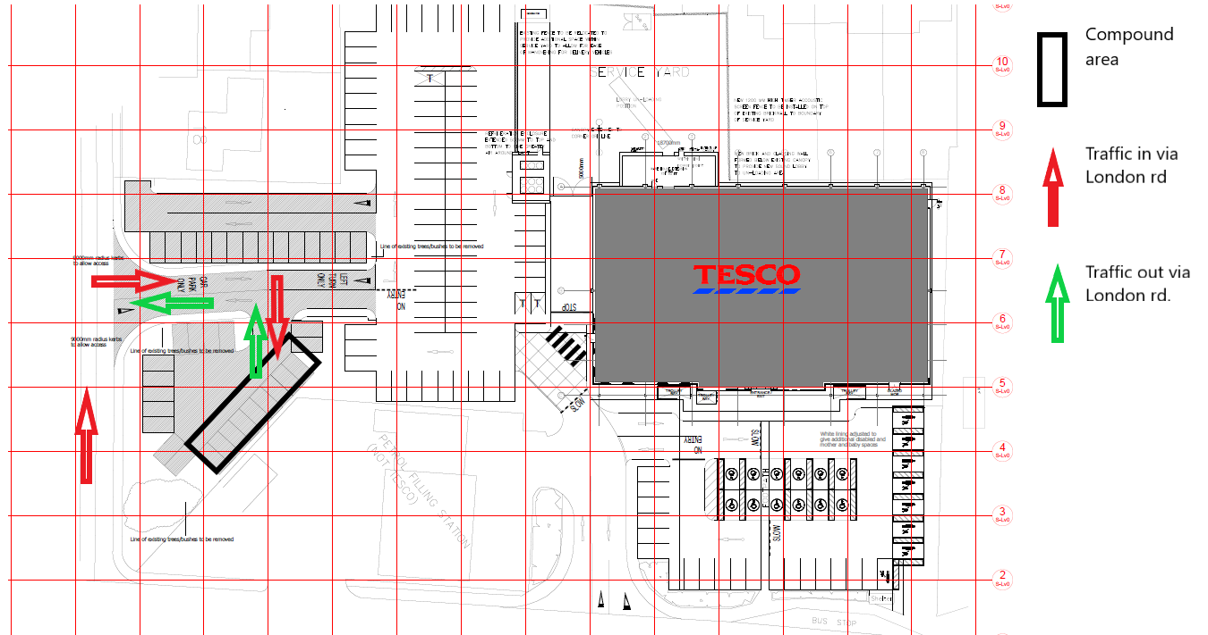
SITE SPECIFIC TOPICS
SITE LAYOUT AND
TRAFFIC MANAGEMENT PLAN

Slide 8
SITE SPECIFIC TOPICS
SITE LAYOUT AND
TRAFFIC MANAGEMENT PLAN
The site office will be located in a section of the car park clearly identified and segregated from customer traffic.
Material storage and facilities will be within the compound area.

Slide 9
SITE SPECIFIC TOPICS
SITE EMERGENCY PROCEDURES
FIRST AID
FIRST AID BOX – LOCATED:
SITE OFFICE
SITE FIRST AIDER(S)
Kizzy - Days
PERSON AUTHORISED TO CALL AMBULANCE
ALL PERSONS ON SITE
DIAL 999- ASK FOR AMBULANCE
Tesco Stores Ltd
London Rd Brandon
IP27 0ER
IVE DETAILS OF INJURY
STAY WITH THE CASUALTY UNTIL HELP ARRIVES
CONTACT THE NEAREST FIRST AIDER
TREAT INJURY USING FIRST AID KIT OR CALL AMBULANCE
GIVE DETAILS OF INJURY AND SITE ADDRESS IF REQUIRED
LOG IN ACCIDENT BOOK (S4)

Slide 10

SITE SPECIFIC TOPICS
SITE EMERGENCY PROCEDURES
FIRE
RAISE THE ALARM
PUSH BUTTON ON FIRE TROLLEY – SHOUT:
FIRE, FIRE, FIRE
ON HEARING THE FIRE ALARM
Turn off all machines
Leave area by quickest emergency route
Do not stop to collect personal belongings
DIAL 999- ASK FOR FIRE SERVICE:
Tesco Stores Ltd London Rd Brandon IP27 0ER
ASSEMBLE FOR ROLE CALL
RAISE THE ALARM
LEAVE THE AREA BY THE NEAREST AVAILABLE EXIT, PROCEED TO ASSEMBLY POINT FOR ROLE CALL
CONTACT THE FIRE SERVICE
GIVE DETAILS AND SITE ADDRESS

Slide 11

SITE SPECIFIC TOPICS
ASBESTOS AWARENESS
R G Carter Group Policy requires that all operatives working on our sites have undertaken within the last 12 months.
An appropriate Asbestos Survey has been carried out for this site and an Asbestos Management Plan in place and communicated where applicable.
However, there remains a of Asbestos being present on site in various areas.
Please familiarise yourself with the Asbestos Management Plan prior to commencing work and sign your understanding of this.
If you suspect you have discovered Asbestos:
YOU MUST!
STOP WORK IMMEDIATELY and notify the R G Carter Site Management Team;
Consult the Information provided in the Asbestos Management Plan;
If in doubt about any of the materials, ISOLATE THE AREA and follow guidance of the Asbestos Management Flow Chart.
YOU MUST NOT!
Disturb any ACM’s at any time;
Store, Lean or rest tools or materials against ACM’s
Remove any Asbestos Identification Stickers or Information Sheets;
Work in areas without making yourself aware of where ACM’s are present.

Slide 12
SITE SPECIFIC TOPICS
SITE SPECIFIC RULES
SITE SAFETY IS YOUR RESPONSIBILITY
ALL R G Carter Group Sites are governed by the following RULES:
All persons on site MUST comply with RG Carter SHE Policies and Procedures and the company rules for safe working. Additional direction may be given at any time by Site Management.
Everybody visiting or working on site is responsible for their own health and safety and that of others who may be affected by their activities.
All operatives or visitors to site must sign in and out each time they arrive or leave site.
The Site Manager has full authority to exclude any person from site who is interfering, misusing or not complying with the Company rules.
Personal Mobile Phones, Radios or other sound producing equipment MUST NOT be used on site.
ALL vehicle and plant drivers entering site MUST make themselves aware of Site Traffic Management Plan prior to entering site and follow this at all times.

Slide 13
SITE SPECIFIC TOPICS
SITE SPECIFIC RULES
SITE SAFETY IS YOUR RESPONSIBILITY
ALL R G Carter Group Sites are governed by the following RULES:
No vehicles or plant are to be left unattended with the engine running or keys left in the ignition.
NO FIRES of any kind are permitted on site.
SMOKING is only permitted in designated areas and not on site.
All persons working on site must be fully trained and competed to safely use the plant, equipment or substances they are working with.
Trainees and young persons will only be permitted on site where they have direct supervision at all times and a suitable Method Statement/Risk Assessment has been carried out for the tasks they are undertaking.
All persons on site MUST wear the appropriate PPE at all times for the task they are doing. Shorts, short trousers and bare tops are strictly prohibited even if they are worn under high-visibility tops.
Abusive or offensive behaviour will not be tolerated in any form inside or outside the site boundaries.

Slide 14

GENERAL TOPICS
COMPETENCY
It is a requirement of R G Carter Group that ALL PERSONNEL working on site hold a current card of Competence.
AS A MINIMUM, a touch screen test must have been passed within the last three months to determine Health and Safety Competence and details of competency should be provided PRIOR to any commencement of works on site.
Cards accepted include: CSCS, CPCS, IPAF
Where there are 4 or more Sub-Contract personnel on Site the Sub-Contractor MUST also provide a Competent Supervisor who holds the Construction Skills two day Site Supervisor qualification as a minimum.
This Supervisor will be responsible for managing his workers on site, communicating with the Site Management Team and ensuring compliance with company policies and industry legislation.

Slide 15

GENERAL TOPICS
PERSONAL SAFETY RULES
REMEMBER: SAFETY IS EVERYBODY’S RESPONSIBILITY
If others around you act in an unsafe manner, it is your duty to report this to the Site Supervisor/Manager.
The HSE are actively pursuing individuals if they find them to be in breach of health and safety regulations.
Always adhere to the following general safety rules on site and pay attention to the Site Specific Safety Rules later in this presentation.
Follow Safe Systems of Work at all times. Read and Understand these BEFORE you commence work.
Follow the Working at Height hierarchy for ALL works at height.
BE AWARE of your surrounding environment and ALWAYS act Safely.
ALWAYS wear the CORRECT PPE for the task.
IF IT’S NOT SAFE, DON’T DO IT!

Slide 16
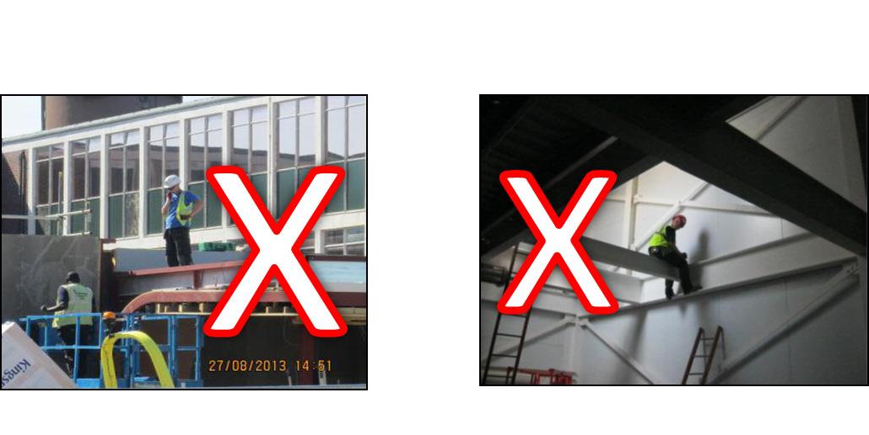
GENERAL TOPICS
WORK AT HEIGHT
REMEMBER: SAFETY IS EVERYBODY’S RESPONSIBILITY
Working at Height remains one of the biggest hazards in our industry. In 2011/12, falls from height accounted for nearly a quarter of all fatal injuries to workers; More than six in ten of all fatal falls took place in construction.
R G Carter policy and Work at Height legislation demands that we only work at height when it has been correctly Risk Assessed, is controlled, and suitable fall protection is in place.
A Ladder or Stepladder of any kind will only be used as a working place in the event that a Risk Assessment determines no other method can be adopted, and ONLY in conjunction with a PERMIT FOR THE USE OF STEPLADDERS.

Slide 17
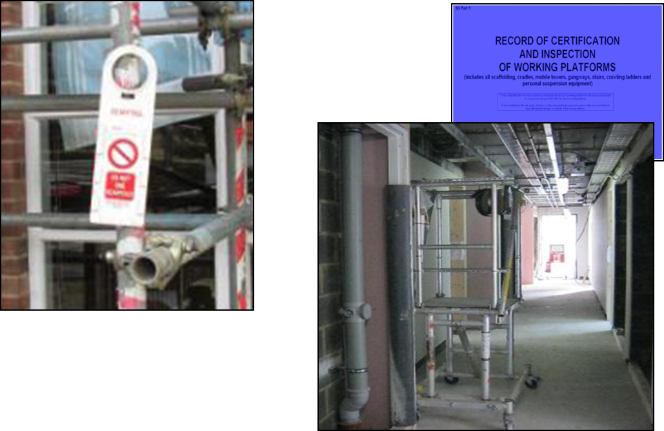

GENERAL TOPICS
WORK AT HEIGHT
REMEMBER: SAFETY IS EVERYBODY’S RESPONSIBILITY
All R G Carter sites operate a 100% scaffold tagging system for all fixed and
mobile scaffold.
All scaffold tags must be installed upon erection of the scaffold, and altered and updated weekly.
Inspections must be recorded in the Record of Certification and Inspection of Working Platforms.
Handover Certificates are required for all Working Platforms and ‘Do Not Alter’ signs fixed at this point.
EXAMPLE GOOD USE OF PODIUM STEPS

Slide 18
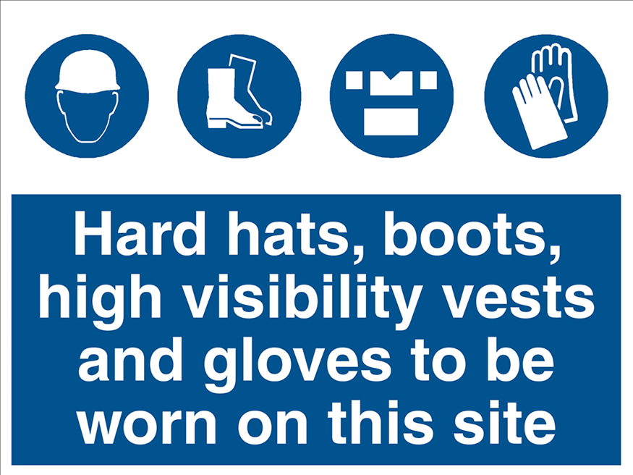
GENERAL TOPICS
PPE
Only Corporate or Client branded PPE should be worn on
R G Carter Sites
Additional PPE is to be worn as required by Risk Assessment or Site Specific Rules.

Slide 19
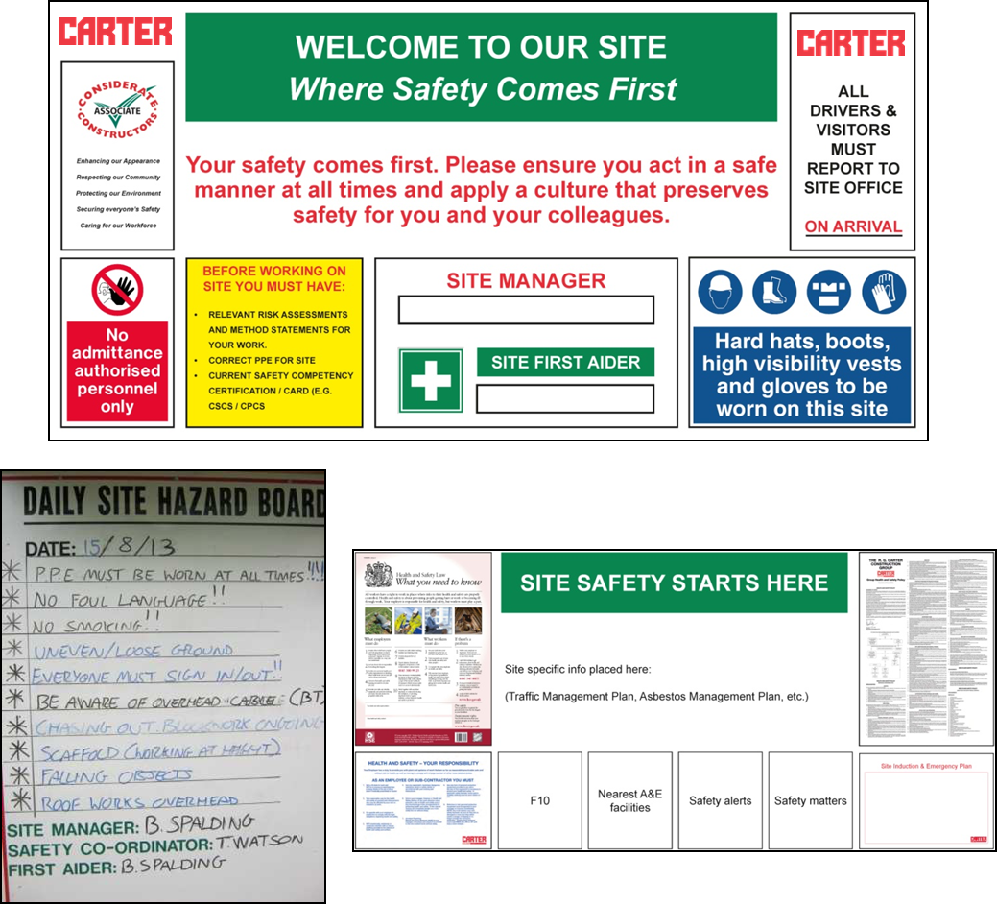
GENERAL TOPICS
SITE SIGNAGE
All RG Carter sites have a DAILY SITE HAZARD BOARD at the entrance. You MUST read this and pay attention to all other site signage before and during your time on site.

Slide 20
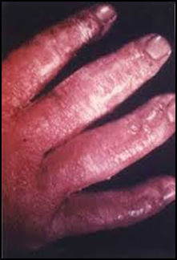
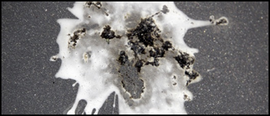
GENERAL TOPICS
OCCUPATIONAL HEALTH:
OCCUPATIONAL ILLNESSES
SKIN: Dermatitis is a painful condition caused by contact with certain materials. Protect yourself by:
Always knowing the COSHH information for the materials you are using;
Using appropriate hand protection (gloves/barrier cream);
Avoiding direct contact with materials known to cause the problem;
Regularly inspecting your hands for dry skin/irritations which can be early signs of the condition and treating these accordingly.
PARROTS DISEASE: Caused by contact or inhalation of dust from bird droppings, Psittacosis can cause inflammation of the liver, haemorrhage and pneumonia.
Protect yourself by:
Maintaining a HIGH level of personal hygiene (wash your hands before eating/drinking etc.);
Avoiding direct contact with bird droppings by wearing PPE and RPE and disposable clothing when necessary.

Slide 21

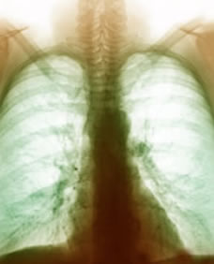
GENERAL TOPICS
OCCUPATIONAL HEALTH:
OCCUPATIONAL ILLNESSES
WEILS DISEASE: (Leptospirosis) is a virus carried in Rats Urine which can enter the body through cuts, or scratch the throat following contact with infected rats urine, cattle urine or contaminated water. Protect yourself by:
Maintaining good hygiene at all times (washing hands before eating/drinking etc.);
Wearing relevant PPE/RPE whilst on site;
Visiting your GP if you experience flu-like symptoms and informing them if you suspect Leptospirosis;
Informing your employer if Leptospirosis is diagnosed.
OCCUPATIONAL ASTHMA: Occupational Asthma is caused directly by work and is usually the result of inhaling certain substances known as respiratory sensitisers over a period of time. The condition can take weeks, months or even years to develop. Protect yourself by:
Protecting yourself from dust as detailed in the next slide
Wearing the relevant PPE/RPE at all times

Slide 22


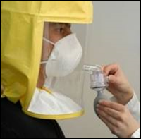
GENERAL TOPICS
OCCUPATIONAL HEALTH:
NOISE/DUST AWARENESS
NOISE: Take responsibility for your own hearing:
Always wear the correct hearing protection whenever you see this sign:
Make sure your hearing protection fits correctly, and is clean;
If you are standing 2m away from someone and you have to shout to be heard, you SHOULD be wearing hearing protection.
DUST & RESPIRATORY: Poor dust and respiratory control may lead to lung disease:
Make every attempt to eliminate the cause of dust or fumes by using alternative processes or substances, use RPE as a last resort;
You must be Face Fit Tested to wear any RPE, a test certificate must be provided.
Be aware of all COSHH information for the products you are using;

Slide 23
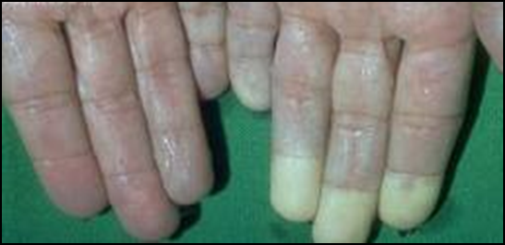
GENERAL TOPICS
OCCUPATIONAL HEALTH:
HAVS
Helping Prevent exposure to Hand Arm Vibration by following these steps;
Avoiding using vibration emitting equipment if possible
Remembering you are responsible too
Always using the correct tools for the job
Ensuring all cutting tools are sharp
Not gripping or facing the tools any more than necessary during operation
Always following guidance as to the trigger time for the tool you are using
Monitoring and recording the duration you use the tool for in the Hand Arm Vibration Register
Keeping your hands warm
Wearing the correct PPE for the job you are doing

Slide 24
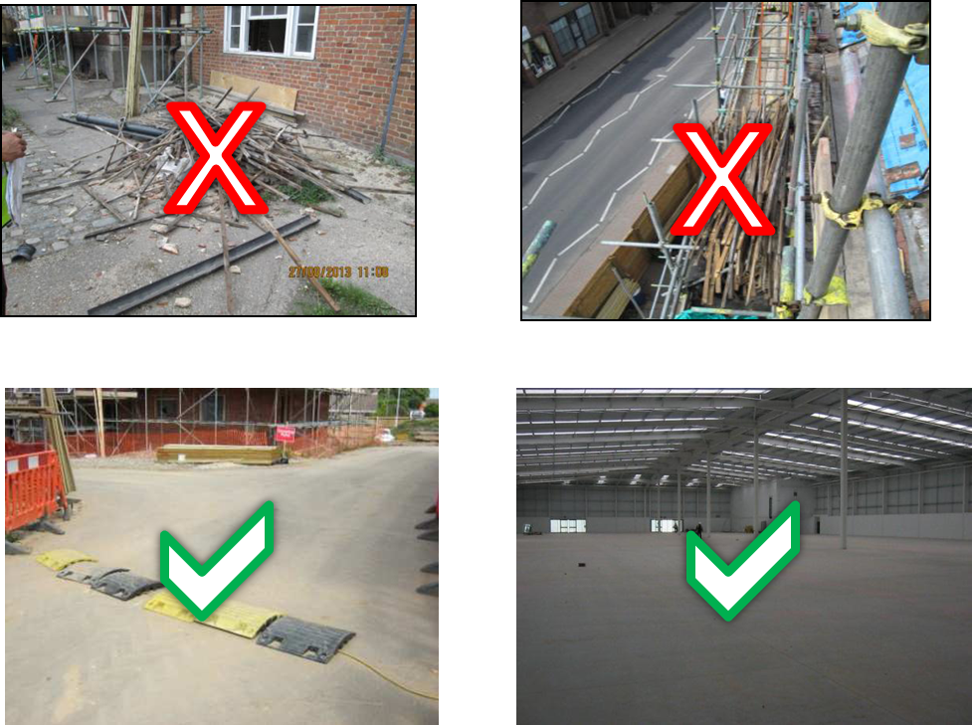
GENERAL TOPICS
HOUSEKEEPING
A TIDY SITE = A SAFE SITE
It is your duty to keep all work areas clean and tidy from debris, to make sure that waste materials are cleared away into the segregated areas and do not infringe on access or exit points.
All Redundant Materials MUST be correctly documented and disposed of. Any unauthorised removal from site is strictly forbidden.

Slide 25
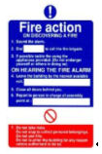

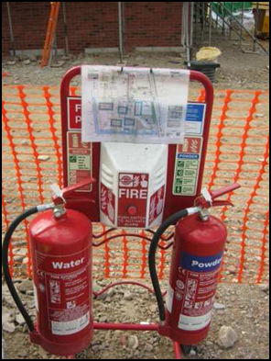


GENERAL TOPICS
FIRE SAFETY
PROTECT YOURSELF BY:
Making yourself aware of the Site Layout, Site Emergency Plan, and Fire Point Locations;
Keeping your work area clean and tidy, and clearing away all combustible materials as you work;
Ensuring FIRE EXITS and ESCAPE ROUTES are clear at all times: NEVER use them as storage areas;
Storing flammable gases, liquids or materials separately and away from any heat sources;
REPORT any obstructed escape routes, missing or discharged extinguishers, or any fire hazards to the Site Management Team;
Make sure you have the relevant permits for ALL HOT WORKS carried out and that you have the correct fire extinguisher close by.
EXAMPLE GOOD FIRE POINT

Slide 26
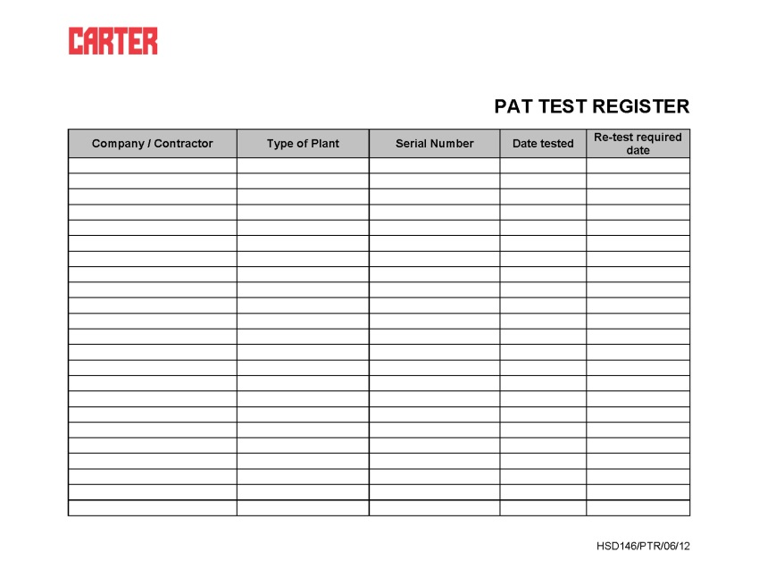
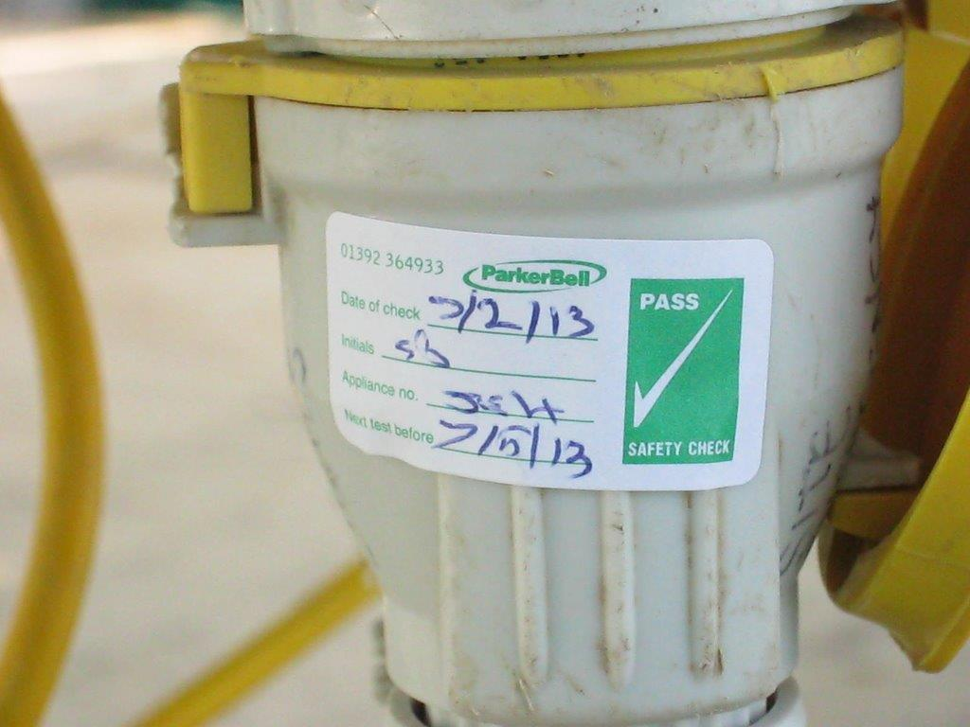
GENERAL TOPICS
ELECTRICAL EQUIPMENT
R G Carter Policy states that only 110v power tools are to be used on site.
All relevant equipment is to be PAT Tested in line with Client’s guidelines, or annually, and marked with a tag/label or proof of certification.
All PAT Testing should also be registered on form HSD 146 Pat Test Register
ALL ELECTRICAL CABLES & LEADS MUST BE TREATED AS BEING LIVE

Slide 27
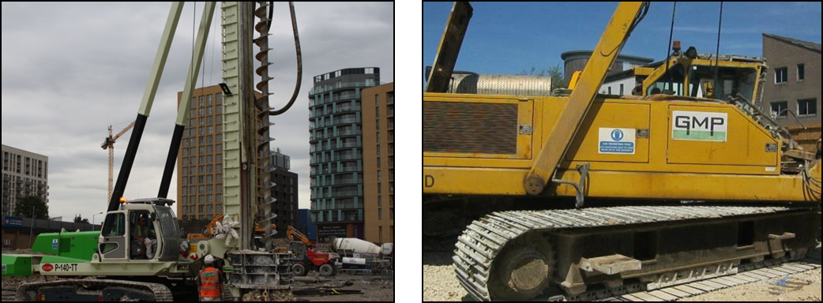
GENERAL TOPICS
PLANT & OTHER
WORK EQUIPMENT
All items of Lifting Equipment or Mechanical Plant used on R G Carter Group sites can only be operated by TRAINED AND CERTIFIED PERSONS.
This includes: Forklifts, excavators, MEWP’s, dumpers & cranes.
All use of such plant MUST be recorded in the Record of Inspection of Lifting and other Work Equipment and the APPROPRIATE CERTIFICATION must be available for inspection at all times, including Record of Thorough Examination for all Lifting Equipment.
No vehicles should be left unattended while on site with the engine running or keys left in the ignition.
All construction vehicles and mobile plant MUST have SEAT BELTS, a WORKING flashing beacon light and visual or audible reversing aids.
The Site Traffic Management Plan MUST be followed at all times

Slide 28
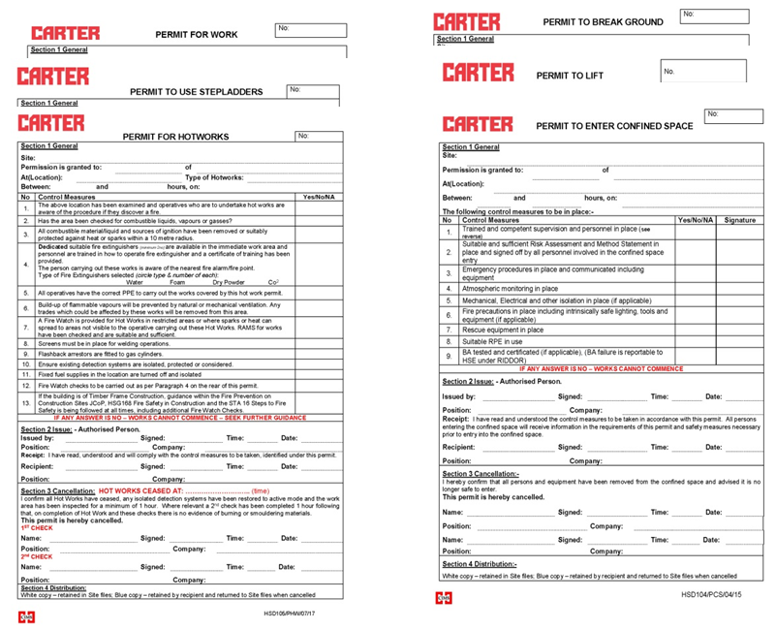
GENERAL TOPICS
PERMITS
All R G Carter Sites operate a PERMIT TO WORK SYSTEM
Before commencing work on all sites you MUST obtain the relevant Permit from the Site Management Team:
Permit to Work
Permit to Break Ground
Permit to Use Stepladders
Permit for Hot Works
Permit to Enter Confined Space
Permit to Lift

Slide 29
GENERAL TOPICS
ACCIDENT/INCIDENT AND
NEAR MISS REPORTING
PLEASE BE ADVISED THE FOLLOWING SLIDE CONTAINS REAL IMAGES OF PERSONAL INJURY AS A RESULT OF POOR HEALTH & SAFETY COMPLIANCE AND CONTROL

Slide 30
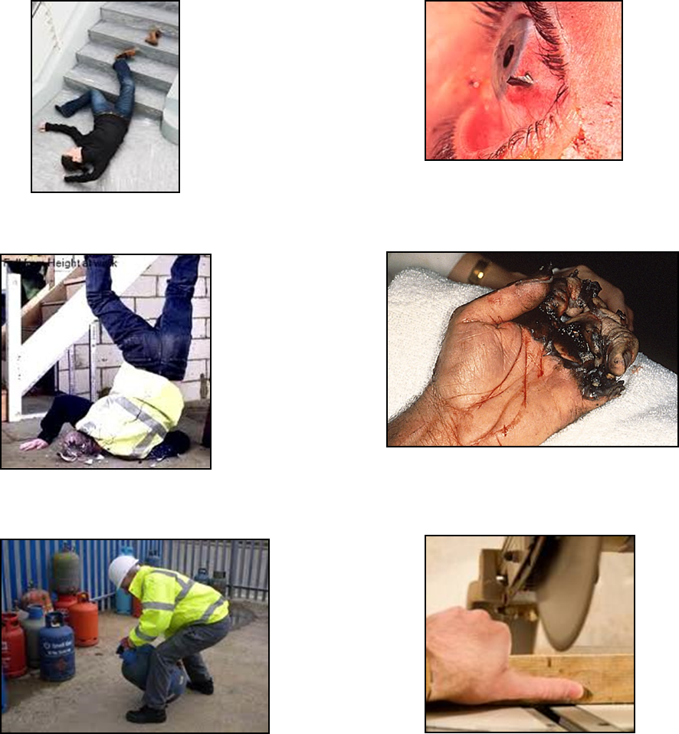
GENERAL TOPICS
ACCIDENT/INCIDENT AND
NEAR MISS REPORTING
LETS BE CLEAR! THE MOST COMMON TYPES OF ACCIDENT WITHIN THE CONSTRUCTION INDUSTRY INVOLVE:
SLIPS TRIPS & FALLS
EYE INJURIES
FALLS FROM HEIGHT
ELECTRIC SHOCK INJURIES
INCORRECT MANUAL HANDLING
CONTACT WITH PLANT & MACHINERY

Slide 31
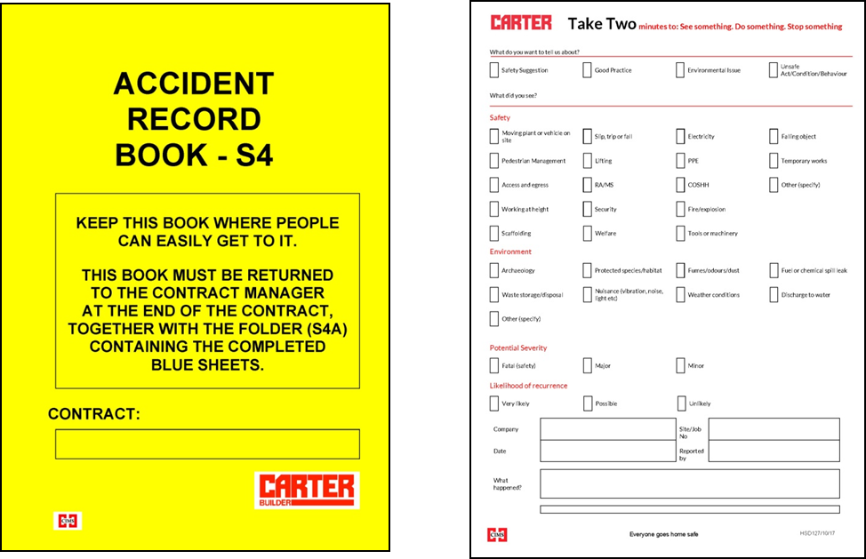
GENERAL TOPICS
ACCIDENT/INCIDENT AND
NEAR MISS REPORTING
Accidents can happen at any time, usually when you least expect it. Every accident, no matter how minor, MUST be reported immediately to the Site Manager and First aider, and entered into the Site Accident Record book (S4).
All Near Miss Incidents MUST also be reported, using
form HSD 127.

Slide 32
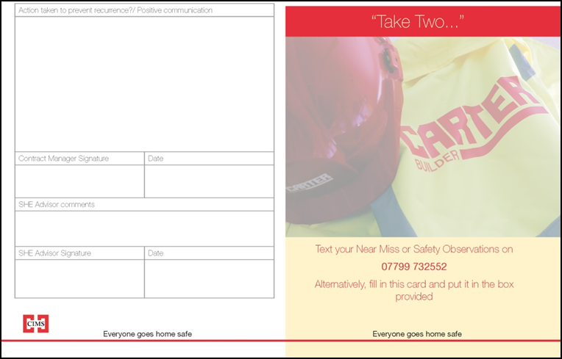
GENERAL TOPICS
TAKE TWO
R G Carter is committed to improving SITE SAFETY.
If you think we can improve in any way we want you to tell us how:
You can find a Take Two card in the site office. Please fill this in and place in the box provided to help us MAKE A DIFFERENCE to your workplace.
YOU are the best placed person to tell us if the PPE you have is appropriate, if something could be done in a safer way. Help us to help you and don’t walk on by.

Slide 33

GENERAL TOPICS
DRUGS & ALCOHOL
The R G Carter Group operates a ZERO TOLERANCE Drug and Alcohol Policy.
Our Policy includes ‘random’ and ‘for cause’ testing and you may be asked to undertake a test if:
As part of a random testing session which could take place at any time.
You are involved in an accident and intoxication is considered to be a potential cause of this;
You are acting suspiciously and intoxication is suspected;
Testing positive on any of these occasions could result in your removal from site, and potential disciplinary action for gross misconduct.
Refusal to take a test when requested will be deemed a positive result and you will be asked to leave site, and your employer informed.
If you have a known medical condition for which you are taking prescription medication that could affect your ability to work please inform your Site Manager and First Aider prior to commencing work.

Slide 34
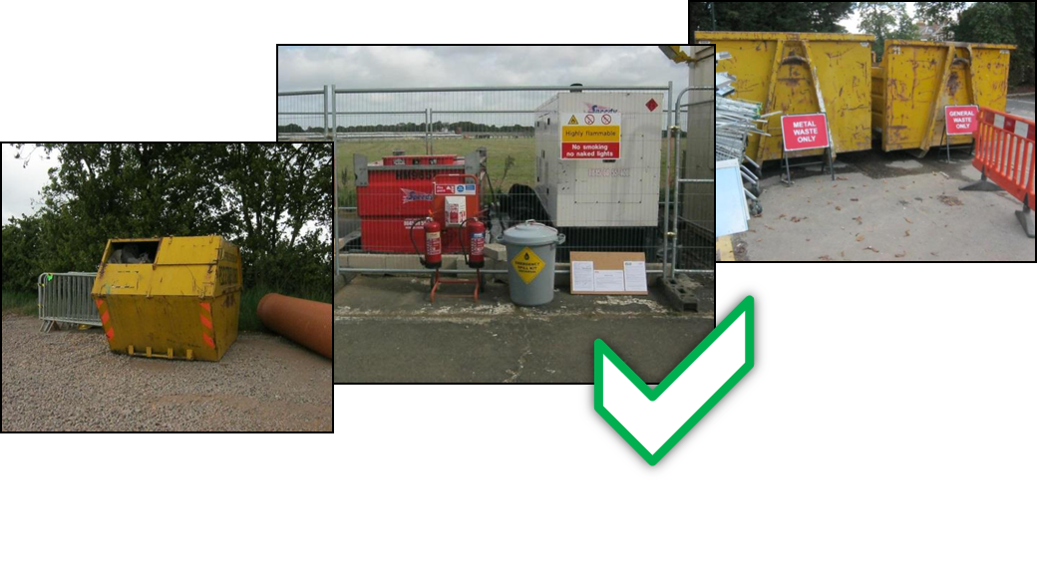
GENERAL TOPICS
ENVIRONMENTAL
AWARENESS
R G Carter has a duty of care to minimise, reuse, and manage waste generated from site activities. Materials and chemicals which are hazardous to health must also be stored in a safe and secure manner.
YOU have a duty of care to ensure this is carried out by:
Ensuring all hazardous materials are stored in a safe and secure manner, away from any flammable items.
Ensuring all waste generated on site is segregated before being removed and recorded according to the Site Waste Management Plan.
Making sure any spills are reported immediately and cleaned up using the spill kit which is located in the site office.
Reading and understanding the site waste management plan and making sure those around you do too.

Slide 35

SITE SPECIFIC TOPICS
CONSIDERATE CONSTRUCTOR SCHEME (CCS)
RG Carter is proud to be a member of the CCS and will adhere to the below Code Of Practice
Constructors should ensure sites appear professional and well managed. Think about the external image and appearance; be organised, clean and tidy throughout; enhance the appearances of facilities, stored materials, vehicles and plant; raise the image of the workforce by their appearance.
Constructors should give utmost consideration to their impact on neighbours and the public. Inform, respect and show courtesy to those affected by the work; minimise the impact of deliveries, parking and work on the public highway; contribute to and support the local community and economy; create and positive and enduring impression and promote the Code.
Constructors should protect and enhance the environment. Identify, manage and promote environmental issues; seek sustainable solutions and minimise waste, carbon footprint and resources; minimise the impact of vibration, air, light and noise pollution; protect the ecology, landscape, wildlife, vegetation and water courses.

Slide 36

SITE SPECIFIC TOPICS
CONSIDERATE CONSTRUCTOR SCHEME (CCS)
RG Carter is proud to be a member of the CCS and will adhere to the below Code Of Practice
Constructors should attain the highest levels of safety performance. Have systems which care for the safety of the public, visitors and workforce; minimise security risks to neighbours; have initiatives for continuous safety improvement; embed attitudes and behaviours that enhance safety performance.
Constructors should provide a supportive and caring working environment. Provide a workplace where everyone is respected, treated fairly, encouraged and supported; identify personal development needs and promote training; care for the health and wellbeing of the workforce; provide and maintain high standards of welfare.

Slide 37
BEFORE YOU GO…
Do you UNDERSTAND what you have been told?
You will now be required to complete a questionnaire to demonstrate your UNDERSTANDING?
Do you have ANY QUESTIONS?
Now SIGN the INDUCTION REGISTER
Take an INDUCTION LEAFLET and place a completed INDUCTION STICKER on your hard hat. YOU MUST NOT REMOVE THIS.
BE SAFE, NOT SORRY AND REMEMBER:
HEALTH AND SAFETY IS YOUR RESPONSIBILITY!!

Slide 38

QUESTIONNAIRE
Print your name & company in the space provided
Answer ALL questions
Hand your sheet back to the Site Manager when asked to and continue to your place of work.
Your questionnaire will now be marked.
Should you be unsuccessful by not reaching 100% you will be asked to re-sit at the next scheduled RGC Safety Induction.

Slide 39
FINAL CHECKS
TAKE A SECOND TO CHECK YOU HAVE:
STEP
Registered all competency certification.
Completed, signed and returned the questionnaire.
Received the RAMS briefing from your supervisor and signed to agree your understanding of this.
Placed a completed Induction Sticker on your hard hat.
Read the Daily Site Hazard Board before you enter the construction area.

